Slide 1
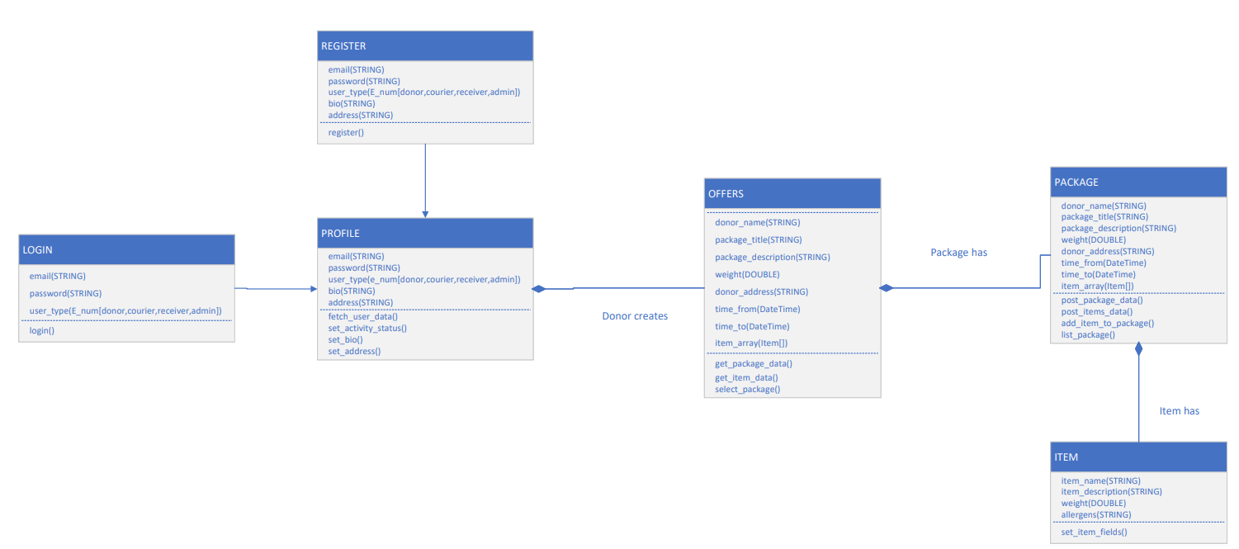
FoodPantry: Class Diagram

